Slide 1

Practical Grammar Present Simple Tense

Slide 2
Affirmative form الاثبات
֎ base verb الفعل تصريف اول بدون اى اضافه
֎ I
֎ We
֎They
֎You
֎They usually_____to school but I always ride my bike.
a) walk
b) walks
c) walked
d) walking
֎ base verb التصريف الاول + (s) / (es) / (ies)
֎ He
֎ She
֎ It
֎ My cousin always ______to school. He lives near.
walks
walk
walking
walked

Slide 3
Present simple
Every
always
Usually
Use Clean verb With→ I / We / They / You
eat – - visits - go – wash– watch– fix– carry – study– have – has – am – is – are
With He / She / It
Irregular verbs
have
s
es
ies
He / She / It → has
eats
visits
I / We / They / You → have
goes
washes
Verb to be
I → am
watches
fixes
guesses
He / She / It → is
carries
studies
We / They / You → are

Slide 4
  Correct the mistake
֎ We often______(helping) mum at home.
help
֎ She never ____(going) to university by plane.
goes
֎ Aya usually___(fix) home devices by herself.
fixes
֎ Give her the message when you___(seeing) her.
see

Slide 5
Negative form النفى
֎ don’t + base verb الفعل تصريف اول بدون اى اضافه
֎ I
֎ We
֎They
֎You
֎They ……often stay up late during school days.
doesn’t
don’t
didn’t
can’t
֎ doesn’t + base verb التصريف الاول بدون أى اضافة
֎ He
֎ She
֎ It
֎ She..…..comes to school by bus. She lives near.
never
doesn’t
don’t
didn’t

Slide 6
  Correct the mistake
֎We ___(not have) Spanish at school.
don’t have
֎ He______(not ride) to school. He lives near.
doesn’t
֎ Shady_____(not goes) to bed early.
doesn’t go
֎He is selfish. He ___(wanting)every thing for himself.
wants

Slide 7
Question form النفى
֎ Do + S + base verb?
֎ I
֎ We
֎They
֎You
֎……….you speak English in class?
Will
Do
Does
Is
Do You____?
Yes, I do.
No, I don’t.
֎ Does + S + + base verb?
֎ He
֎ She
֎ It
֎--------------wood float if you throw it in water?
Will
Do
Does
Is
Does he__?
Yes, he does.
No, he doesn’t

Slide 8
Question form النفى
֎ I
֎ We
֎They
֎You
֎ Question word + do + Plural Subject + base verb?
I live in a small village in Giza. (Where)
Where do you live?
֎ He
֎ She
֎ It
֎ Question word + Singular Subject + does + base verb?
My father works in a bid company. (Where)
Where does your father work?

Slide 9
Present simple
How + do + S + Base verb?
How + does + S + Base verb?
֎How_____________ you spend your summer holiday?
does
do
did
are
֎ How……your father often go to work?
is
does
do
did

Slide 10
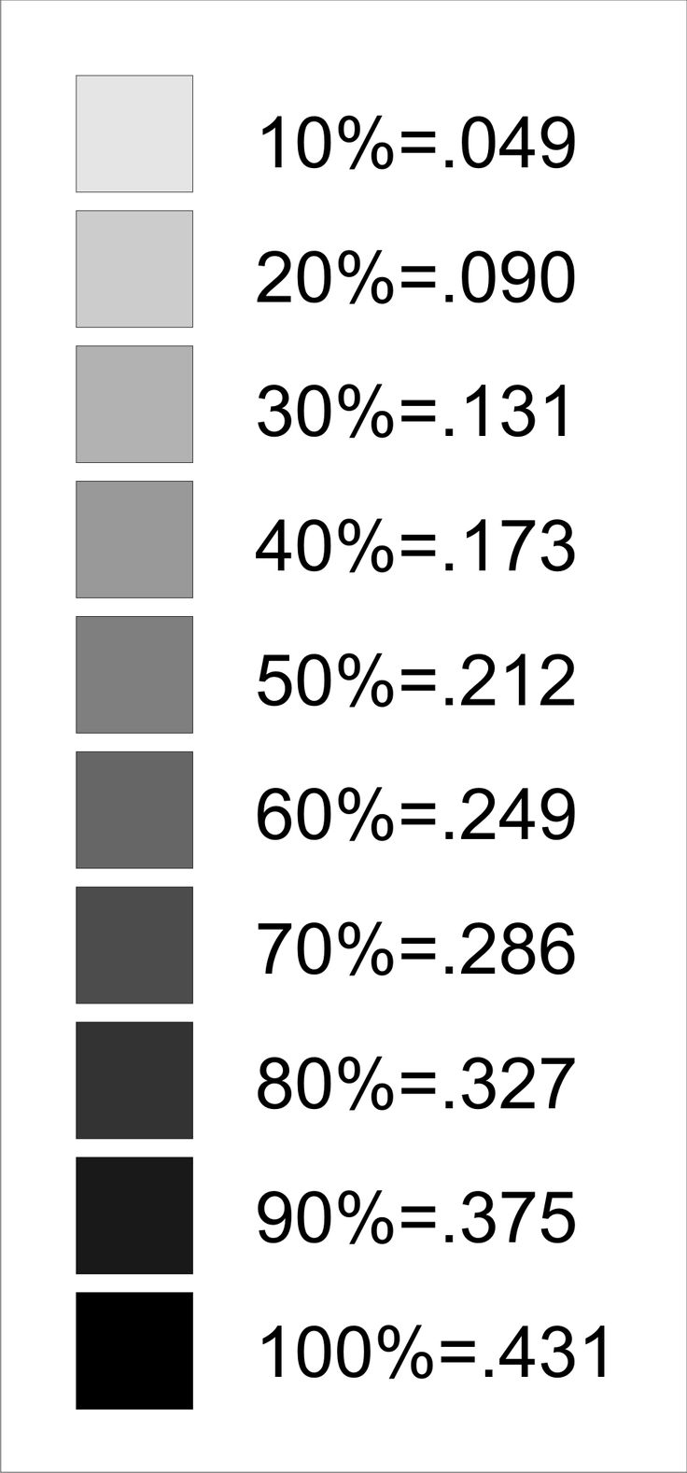
Adverbs of frequency ظروف التكرار
always (تكرار 100%) دائما
often (تكرار 80%) غالبا
0
usually (تكرار 70 %) عادة
rarely نادرا
hardly ever بالكاد
Sometimes أحيانا
regularly بشكل معتاد
never
ظروف التكرار تتى قبل الافعال.
She never lies.
ظروف التكرار تتى بعد verb to be
We are never late.

Slide 11
  Correct the mistake
֎ She ______(goes sometimes) to school late.
Sometimes goes
֎ She ____(goes never) to university by plane.
never goes
֎ Aya ___(fixes usually) home devices by herself.
usually fixes
֎ They___(never are) late to work.
are never

Slide 12
֎ Rewrite the following sentence:
He speaks English all the time. (always)
He always speaks English.
Our teacher asks questions from time to time. (occasionally)
Our teacher asks questions occasionally.
We never come to school late. (are)
We are never late to school.

Slide 13
Time phraseالعبارة الزمنية
֎ Every day
֎ every week
֎ On Fridays
֎in the morning
֎ How often ?
֎ Once مره a week
֎ Twice مرتان a day
֎ Thrice ثلاث مرات
֎ 4 times a week.
تاتى فى بداية او نهاية الجملة.
He eats fish every week.
تاتى فى نهاية الجملة و تجيب على سؤال How often?
How often do eat fish?
I eat fish twice a week.
A: ........................................ ................................ ?
B: He eats fish twice a week.
How often does he eat fish

Slide 14
֎ My brother ……….. me with my homework. He is really helpful.
often helps
help often
often help
helps often
֎ Our boss………..earlier than us. He is really energetic
usual arrives
usually arrives
arrives usually
never arrives
14

Slide 15
֎ ……………, dad asks me to park his car. He knows that I am a good driver.
Sometimes
never
usually
hardly ever
֎ She ………….on time. She never comes late.
always is
is always
is never
never is
15

Slide 16
֎ Toyota cars ………… fast and expensive.
are often
often are
have often
often have
֎ Most girls ……………..of afraid dogs and rats. They become scary easily.
are sometimes
sometimes are
are never
never are
16

Slide 17
֎ My cousin often_____(walking) to school. She lives near.
Habits and routine
عادات و روتين
walks
֎ They often______(spending) the summer in Alex.
spend
General truth
حقائق عامه
Usage الاستخدام
֎ Most girls ___________(having) long hair.
have
Facts الحقائق
֎ Water__(boiling) at hundred degrees.
boils

Slide 18
Future according to timetable
مستقبل بجدول زمنى
֎ The plane _____(leaving) the airport at seven tomorrow.
leaves
֎ Our lesson ___(starting) at three in the evening .
Series of events
سلسلة أحداث
starts
Usage الاستخدام
֎ First , we cut the vegetables, then we add spices. Finally we ____(baking) it in the oven for an hour.
bake
After Linkers
بعد الروابط
֎ Before she _____(check)the morning report, she will drink a cup of coffee
checks

Slide 19
If Zero case
حالة If الصفريه
If we heat water, it_____(turning) into steam.
turns
֎ If he____(getting) ill, he often takes an asprin.
gets
Usage الاستخدام
֎ Salah will score if he____(playing) the next game.
If first case
حالة If الاولي
plays
֎ If iron is heated, it____(expanding)
expands

Slide 20
1) They'll have a meal before the plane………….off.
takes
will take
took
had taken
2) Scientists ………….to find more sources of renewable energy.
is wanted
are wanted
has wanted
want
20

Slide 21
3) My Father-----------------the newspaper every morning.
reads
read
has read
is reading
4) Being a volunteer means that you don't---------paid.
are
be
get
getting
21

Slide 22
5) The metro ………..by thousands of people all over the world.
is taken
was taken
takes
is taking
6) English language ………….all over the world.
is spoken
was spoken
speaks
is speaking
22

Slide 23
Passive sentence جملة للمجهول
֎ Object + am/is/are + P.P + by Subject
My mother always tidies my room. (Begin with My room)
My room is always tidied by my mother.
Our teacher signs our homework after school. (Make passive)
Our homework is signed after school.
My father sometimes takes us to school. (We)
We are sometimes taken to school by my father.

Slide 24
Passive Negative نفى للمجهول
֎ Object + am not / isn’t / aren’t + P.P + by Subject
They don’t open this shop on Fridays. (Make passive)
This shop isn’t opened on Fridays.
Our teacher doesn’t sign our homework inside the class. (isn’t)
Our homework isn’t signed inside the class.
We don’t ever break school rules. (make Passive)
School rules aren’t ever broken by us.

Slide 25
Passive Yes- No Question السؤال
֎ Am / Is / Are + Object + P.P?
Do the village farmers sell vegetables in the market? (sold)
Are vegetables sold in the market?
Does your mother make your cakes and bread at home? (made)
Are your cakes and bread made at home by your mother?
Do your friends invite you to their birthdays? (Are)
Are you invited to your friend’s birthdays?

Slide 26
Passive with Question Word
֎ Question word + am / is / are + Object + P.P?
Where do the village farmers sell vegetables? (sold)
Where are vegetables sold11?
How does Mom make cakes and bread at home? (made)
How are cakes and bread made at home by your mother?
When do your friends invite you to home? (When are)
When are you invited to your friend’s home?

